Slide 1
MEDICATIONS IN
Pregnant and Lactating Patients

Slide 2
Physiological changes in pregnancy
Total body water is increased by approximately 8 litres, leading to altered drug distribution.
Pregnancy also increases cardiac output,
the rate of liver metabolism,
plasma volume,
glomerular filtration and fat stores.
These physiological changes cause plasma drug concentrations to be reduced in pregnancy.
It is important to carefully monitor medications and their effects during pregnancy to ensure that the doses used are as low as possible but provide an adequate therapeutic response.

Slide 3
Placental transfer
Factors affecting the rate of drug transfer through placenta:
  Metabolic status
  Gestational age of the fetus
  Drug’s protein binding, ionisation, lipid solubility and MW.
Misconception: placental barrier provides protection to the fetus;
However, almost all drugs are able to pass freely through the placenta, with only those with a MW >1000 Da being unable to do so, e.g., insulin and heparin.

Slide 4
Teratogenicity
Teratogen: A drug which when exposed in utero, directly or indirectly causes structural or functional abnormalities in the fetus or in the child after birth.
Structural malformations: the effects of thalidomide, which were first recognised in the 1960s.
Intrauterine growth retardation: beta-blockers (most notably atenolol), have been associated with intrauterine growth retardation (IUGR) probably due to increased fetal and utero-placental peripheral vascular resistance and reduced placental blood flow.

Slide 5
Diethylstilbestrol, which was used to prevent recurrent miscarriages, is now known to cause transplacental carcinogenicity; in-utero exposure is associated with problems in later life such as infertility in both male and female offspring and a rare form of vaginal cancer.
Neuropsychological and behavioural abnormalities may also occur after drug exposure. Some antiepileptic drugs and drugs of abuse have been associated with learning and behavioral problems (in the child) following in-utero exposure.

Slide 6
GESTATION MAY BE DIVIDED INTO 4 MAJOR STAGES
1. Pre-implantation stage (blastocyst formation): lasts 16 days; i.e. from conception to implantation. Shows “all-or-none” effect; i.e. either killing the embryo or not affecting it at all. No teratogenesis.
2. Period of organogenesis (from 17th to 56th day): During this period, drugs may produce a) no measurable effect; b) abortion; c) a sublethal gross anatomic defect; or d) a permanent subtle metabolic or functional defect
3. 2nd and 3rd trimesters: drugs can cause teratogenicity or other effects such as retardation of physical or brain growth, behaviour defect, premature labour, neonatal toxicity or even post-natal effects such as cancer in later life.
4. Labour-delivery stage: danger of toxicity in the neonatal period.

Slide 7
TIMING OF EXPOSURE
During the preimplantation stage, in very early pregnancy, exposure to a drug is unlikely to produce a teratogenic effect due to an inbuilt ‘recovery process’ in the concept us.
If a ‘teratogenic insult’ occurs and there is damage to only a small number of cells then ‘compensation’ occurs whereby the remaining viable cells continue to divide to replace any damaged cell(s).
However, if a large number of cells are damaged then implantation will not occur and the pregnancy will be lost. This is known as the ‘all or nothing’ or totipotent period.

Slide 8
The 10 weeks following implantation are the most sensitive as this is the time during which major structural changes and organogenesis are taking place (major organs and limbs develop).
Teratogenic effects resulting in fetal malformations are:
dose related (how much drug)
time related (when, and for how long the drug exposure occurs)
While the first trimester is the most sensitive period to structural malformations, some drugs may affect the fetus in the later stages of pregnancy, so care should be taken when prescribing throughout pregnancy.
  E.g.,: exposure to ACE inhibitors in the second and third trimesters can cause serious adverse effects such as oligohydramnios(lack of amniotic fluid); growth retardation; lung and kidney hypoplasia; and hypocalvaria. (Hypocalvaria is a condition in which the cranial bones are hypoplastic.)

Slide 9
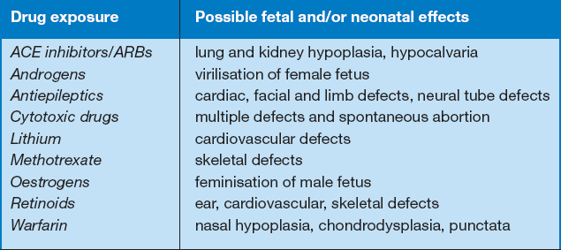
DRUGS WHICH ARE FETOTOXIC WHEN TAKEN IN THE 1ST TRIMESTER

Slide 10
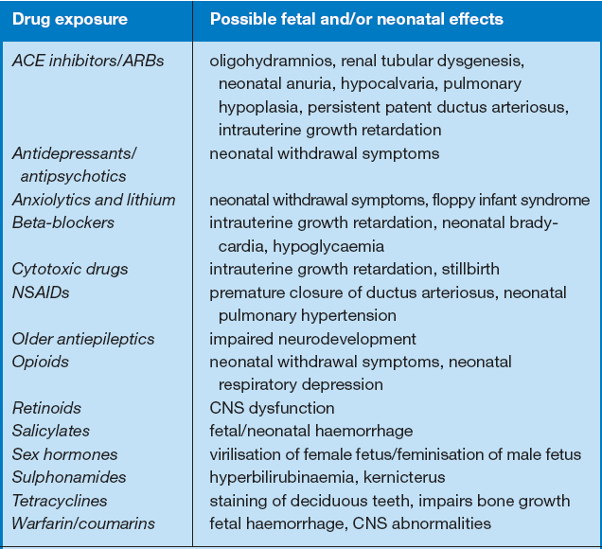
Drugs which are fetotoxic when taken in the 2nd & 3rd trimester

Slide 11
Important to carry out an individual risk assessment when considering prescription of a drug in pregnancy.
Not practically possible to produce lists of ‘safe’ drugs and drugs that must always be avoided.
In certain cases it may be necessary to prescribe a suspected teratogen, as the benefit may outweigh the risk due to the severity of the maternal condition, or stage of pregnancy.
Expert advice should be sought whenever there is any doubt about drug safety in pregnancy.

Slide 12
General considerations when prescribing in pregnancy
The risk posed by drug use in pregnancy can be minimized through pre-pregnancy counselling.
Folic acid supplementation can be initiated and treatment optimized to ensure that the safest medications are used.
When prescribing for a pregnant patient, consideration should be given to whether medication is absolutely necessary. Often non-drug measures may be sufficient. E.g.,:
  dietary measures may alleviate common conditions such as nausea and constipation;
  behavioural therapy and counselling may be adequate in the management of anxiety and mild depression.
It is important to balance the risk of drug treatment (to the fetus) against the risks (to both mother and fetus) from failing to treat the maternal condition.

Slide 13
All drugs in pregnancy should be prescribed in the lowest dose for the shortest possible time.
Drugs may act synergistically in terms of teratogenic potential and for this reason monotherapy is desirable when possible. E.g.,: Polytherapy with antiepileptic drugs poses a higher risk to the fetus than monotherapy.
The case for each drug should be assessed on an individual patient basis.

Slide 14
Factors contributing to drug concentrations in the fetus
Major factor is the concentration of drug present in the mother.
Other contributing factors include:
gestational age of the fetus
the degree of placental development (placental blood flow
volume and surface area)
drug’s profile (molecular size; lipid solubility; protein binding characteristics)
degree of drug ionization in the physiologic pH

Slide 15
FDA PREGNANCY RISK FACTOR CATEGORIES
Based on submitted clinical study information reviewed as part of the drug approval process, the Food and Drug Administration (FDA) assigns one of five pregnancy risk factors based on the degree of risk that use of the drug would potentially cause to the fetus.
Category A: Controlled studies in pregnant women…
  fail to demonstrate a risk to the fetus in the 1st trimester
  no evidence of a risk in later trimesters
  possibility of fetal harm appears remote.

Slide 16
Category B: Either…
animal-reproduction studies have not demonstrated fetal risk but there are no controlled studies in pregnant women,
OR
animal-reproduction studies have shown adverse effect (other than a decrease in fertility) that was not confirmed in controlled studies in women in the first trimester (and there is no evidence of a risk in later trimesters.)

Slide 17
Category C: Either…
pre-clinical studies have revealed adverse effects on the fetus (teratogenic or embryocidal) but there are no controlled studies performed in pregnant women,
OR
pre-clinical and clinical study data are not available.
Drugs should be given only if the potential benefit justifies the potential risk to the fetus.

Slide 18
Category D:
Positive evidence of human fetal risk, BUT
the benefits from use in pregnant women may be acceptable despite the risk.
e.g. if the drug is needed in a life-threatening situation or for a serious disease for which safer drugs cannot be used or are ineffective.

Slide 19
Category X:
Pre-clinical and clinical studies have demonstrated fetal abnormalities
OR
There is evidence of fetal risk, and the risk of the use of the drug in pregnant women clearly outweighs any possible benefit(s).
The drug is contraindicated in women who are or may become pregnant.

Slide 20
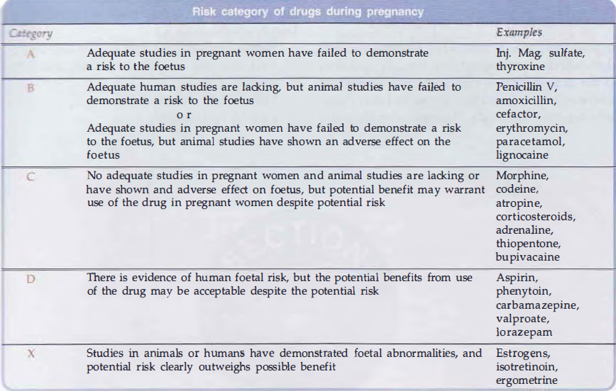

Slide 21
COMMONLY USED DRUGS IN PREGNANCY AND THEIR CATEGORIES
Drugs | Categories
Analgesics and Antipyretics (zydol) | B and C
Acetaminophen(Napa) | B
Phenacetin(vicks) | B
Aspirin(Ecosprin) | C
Antiemetics(Emistat) | B and C
Doxylamine(gestrenol) | B
Meclizine(emezin) | B

Slide 22
COMMONLY USED DRUGS IN PREGNANCY AND THEIR CATEGORIES
Drugs | Categories
Cyclizine(marezine) | B
Dimenhydrinate(pedeamine) | B
Antibiotics | B, C and D
Penicillin, Ampicillin, Amoxycillin, | B
Cloxacillin Cephalosporins | B
Erythromycin(erocine) | B
Gentamicin(gentin) | C

Slide 23
COMMONLY USED DRUGS IN PREGNANCY AND THEIR CATEGORIES
Drugs | Categories
Amikacin(kacin) | C/D
Streptomycin | D
Sulphonamides(burnsil) | B/D
Tetracyclines(tetrax) | D
Amoebicides(Filmet)
Anthelmentics | -

Slide 24
COMMONLY USED DRUGS IN PREGNANCY AND THEIR CATEGORIES
Drugs | Categories
Albendazol | B
Mebendazole | B
Antimalarials | C
Antifungals | C
Anti TB Drugs | B and C
Ethambutol | B
INH | C

Slide 25
COMMONLY USED DRUGS IN PREGNANCY AND THEIR CATEGORIES
Drugs | Categories
Pyrazinamide | C
Vitamins | -
B,C,D,E,folic acid | A
Hormones | -
Thyroxin | A
Androgens | X
Estrogens | X

Slide 26
COMMONLY USED DRUGS IN PREGNANCY AND THEIR CATEGORIES
Drugs | Categories
Progestogens | -
Hydroxyprogestrone | D
Medroxyprogestrone | D
Norethindrone | X
Norgestrel | X
Bronchodilators | C

Slide 27
Prescribing Considerations for Women Who Are Breast feeding
Clinical information concerning the safety of drug use while breast-feeding an infant is often more limited than information regarding the safe use of drugs during pregnancy.
Almost all drugs transfer into breast milk and this may carry a risk to a breastfed infant.
Factors to consider:
  drug characteristics (including lipid solubility, protein binding ability, degree of ionization, and ADME);
  dose received by the infant via breast milk,
  effect of the drug in the infant.

Slide 28
Drug transfer from maternal plasma to milk is mostly by passive diffusion across biological membranes.
Transfer is greatest in the presence of low maternal plasma protein binding and high lipid solubility.
Drugs that are poorly absorbed or have high first-pass metabolism are less likely to cause adverse effects to the breast-fed child.
E.g.,: Gentamicin is highly hydrophilic and is very poorly absorbed when administered orally. If gentamicin is ingested via breast milk, it is unlikely to be absorbed in the infant.

Slide 29
Milk is slightly more acidic than plasma (pH of milk is approximately 7.2 and plasma is 7.4) allowing weakly basic drugs to transfer more readily into breast milk.
Milk composition varies within and between feeds and this may also affect transfer of drugs into breast milk. E.g.,: milk at the end of a feed (hindmilk) contains considerably more fat than foremilk and may concentrate fat-soluble drugs.
Milk to plasma (M/P) concentration ratio: Drugs transfer into breast milk is most commonly described quantitatively using the M/P concentration ratio.

Slide 30
The accuracy of this value is improved if it is based on AUC curves of the drug in maternal milk and plasma (M/P AUC).
Dose received by the infant via breast milk can be calculated by:
D_{(infant)} = C_{(maternal)} x M/P_{(AUC)} x V_{(infant)}
Units: D_{(infant)} in mg/kg/day; C_{(maternal)} in (mg/L); V_{(infant)} in (L/kg/day)
The volume of milk ingested by infants is commonly estimated as 0.15L/kg/day.
The infant dose (mg/kg) can then be expressed as percentage of the maternal dose (mg/kg).

Slide 31
An arbitrary cut-off of 10% has been selected as a guide to the safe use of drugs during lactation.
Drugs such as lithium (infant dose as high as 80% of the weight-adjusted maternal dose) and amiodarone (infant dose up to 50%) should be avoided due to high infant exposure and potential for significant toxicity.
For drugs with greater inherent toxicity (cytotoxic agents, ergotamine, gold salts, immunosuppressives), the cut-off of 10% is too high and breastfeeding is contraindicated.

Slide 32
TOPICAL PREPARATIONS
Maternal use of topical preparations (creams, nasal sprays or inhalers) would be expected to carry less risk to a breastfed infant than systemically administered drugs.
This is due to relatively lower maternal drug plasma concentrations and therefore, lower transfer into breast milk.
However, the risk to the infant must be considered in relation to the toxicity of the drug used, the dosage regimen and the area of application.
E.g.,: use of corticosteroids nasal sprays or inhalers in standard doses would be considered compatible with breastfeeding.

Slide 33
ISSUES
Infants have lower drug clearance, impaired metabolic processes (phase1 oxidation and phase 2 glucuronidation) than adults.
  Drugs subject to high first-pass metabolism may have higher oral availability in premature or term infants due to impaired ability to metabolise on first-pass.
Minimise risk to the breastfed infant by reducing drug exposure
  The overall risk of a drug to a breastfed infant depends on the concentration in the infant's blood and the effects of the drug in the infant.
  If, after assessment of the risks and benefits, the decision is made to breastfeed while the mother is using a drug, the infant should be monitored for adverse effects such as failure to thrive, irritability and sedation.
  However, it is difficult to identify adverse reactions occurring in neonates.
  Feeding immediately prior to a dose may help to minimise infant exposure as concentrations in milk are likely to be lowest towards the end of a dosing interval.

Slide 34
FACTORS AFFECTING AMOUNT OF DRUG RECEIVED BY THE INFANT
Milk yield
Colostrum versus Mature milk
Concentration of drug in the milk
How well the breast was emptied during the previous feeding
Infants ability to absorb, detoxify, and excrete the drug

Slide 35
TRANSFER OF MEDICATIONS INTO BREAST MILK
Concentration gradient
  Passive diffusion of non-ionized and free (non-protein bound) meds
  Maternal serum drug concentration
  volume of distribution (Vd) and half-life
  Retrograde diffusion of drug from breast milk to plasma
Notes:
The most important factor in infant exposure through breast milk is the amount of medication in the mother’s serum.Pass from the maternal plasma compartment through capillary wall into the alveolar cells to penetrate the breast milk.

Slide 36
TRANSFER OF MEDICATIONS INTO BREAST MILK
Lipid solubility
Molecular weight
Maternal plasma levels
Maternal protein binding
Oral bioavailability, half life
Ion trapping (pKa)
Notes:
We will spend a few moments to review each of these factors that determine penetration into medications into breast milk.

Slide 37
LIPID SOLUBILITY
Drugs that are highly lipid soluble penetrate milk in higher concentrations
Avoid extremely lipid soluble drugs.
Examples: Diazepam, phenobarbital
Notes:
Drugs that are very lipid soluble penetrate in milk in higher concentrations almost without exception. Of particular interest are the drugs that are active in the CNS. CNS active drugs invariably have the unique characteristics required to enter milk. Therefore, if a drug is active in the CNS, higher levels in milk are expected; although the amounts still are often subclinical. Examples include drugs like Diazepam and Phenobarbital.

Slide 38
MOLECULAR WEIGHT
The lower the molecular weight (<200 D), the greater penetration into milk
Molecular weights <300 D : (eg. Alcohol, amphetamines, diet pills)
Molecular weights ≥ 600 D : (eg. Heparin, Enoxaparin, Insulin, Remicade)
Larger the molecular weight/size (preferred)
Notes:
The molecular weight of a medication is a significant determinant as to the entry of that medication into human milk. Medications with small MWs (<200 daltons) can easily pass into milk traversing small pores in the cell walls of the mammary epithelium. Examples of low MW drugs include: alcohol, amphetemines, diet pills. Drugs with higher molecular weights must traverse the membrane by dissolving in the cell’s lipid membranes, which may significantly reduce milk levels. Examples include Heparin, Enoxaparin, Insulin, Remicade. Larger molecular weight or size agents are preferred due to the reduced amounts that enter into the milk compartment.

Slide 39
MATERNAL PLASMA LEVEL
The most important determinant of drug penetration into milk
As maternal plasma levels rise, the concentration in milk rises
Drug delivery systems that result in low maternal plasma levels are preferred in breast feeding mother (eg. Inhaler med, topicals)

Slide 40
MATERNAL PROTEIN BINDING
Most important parameter in choosing a safe drug for a nursing mother
Most drugs circulate in the maternal plasma bound to albumin
“Free” or “Unbound” drug transfers into milk
Drugs that are highly protein bound remain in the maternal plasma and don’t penetrate tissues or breast milk
Notes:
Protein binding also plays an important role. Drugs circulate in the maternal plasma, either bound to albumin or freely soluble in the plasma. It is the free component “unbound fraction” that transfers into milk, while the bound fraction stays in the maternal circulation. Examples: warfarin and many NSAIDs. Levels are reduced in milk simply because they are excluded from the milk compartment. This is one of the single most important physiologic parameters to consider when choosing a safe medication for a nursing mother.

Slide 41
ORAL BIOAVAILABILITY
The amount of drug that is absorbed by the infant’s GI tract and reaches the circulation
Low oral bioavailability: aminoglycosides, heparin, insulin, omeprazole
Action of a drug in the GI tract may produce SE: diarrhea, constipation, PMC
Notes:
Once a drug has entered the mother’s milk and has been ingested by the infant, it must traverse or pass through the infant’s GI tract prior to absorption. Some drugs are poorly stable in this environment due to the proteolytic enzymes and acids present in the infant’s stomach. Examples of drugs with low oral bioavailability in the infant include. Aminoglycosides, heparin, insulin, omeprazole, and other large peptide drugs. Other drugs are poorly absorbed by the infant’s gastrointestinal tract and do not enter the infant’s blood stream. Thus oral bioavailability is a useful tool to estimate just how much of the drug will be absorbed by the infant. Realize also that some drugs that exert their action in the GI tract may produce local side effects in the infant causing diarrhea, constipation, or PMC.

Slide 42
ION TRAPPING (PKA)
Ion trapping – drug becomes trapped in milk compartment (due to low pH milk)
pKa is the pH where a drug is equally ionic or nonionic (the more ionic, less transfer from milk to plasma)
Drugs with high pKa (>7.2), have higher Milk/Plasma ratio (eg.Phenobarbital, iodinated drugs)
Choose drugs with a low pKa
Notes:
Drugs are trapped in milk (ion trapping) due to the low pH of human milk (7-7.2). With drugs with a high pKa, the ionic state of the drug changes and stops its exit back into the maternal circulation. This is important for weak basic drugs, such as barbiturates (like phenobarbital with high pKa).

Slide 43
DRUGS THAT DECREASE MILK SUPPLY
Nicotine
Alcohol
Sedating Antihistamines (eg. Diphenhydramine)
Estrogen containing oral contraceptives
Progesterone contraceptives (if started early postpartum before milk supply established)
Bromocriptine (Parlodel)

Slide 44
DRUGS THAT AID IN MILK PRODUCTION:
GALACTAGOGUES
Herbals: Fenugreek
Metoclopramide (Reglan)
Domperidone (Motillium)
Synthetic Oxytocin nasal spray
Notes:
In the US it is estimated that 15% of breast feediing mothers use herbal galactagogues. Four herbs (shatavari, tobangun, fenugreek, milk thistle) with potential use as galactagogues have been studied. Currently the Academy of Breast feeding Medicine does not recommend use of herbals as galactagogues.

Slide 45
DR. HALE’S LACTATION RISK CATEGORY
L1 Safest: Drug taken by larger # of breast feeding women without any observed adverse effects in infant
L2 Safer: Drug studied in a limited # of breast feeding women without any observed adverse events in infants
L3 Moderately Safe: No controlled trials in breast feeding women, but risk of untoward effects is possible

Slide 46
DR. HALE’S LACTATION RISK CATEGORY
L3 Moderately Safe: No controlled trials in breast feeding women, but risk of untoward effects is possible OR controlled studies show only minimal non-threatening adverse effects
L4 Potentially Hazardous: Positive evidence of risk to the breastfed infant OR to the breast milk production but benefit outweighs the risk

Slide 47
DR. HALE’S LACTATION RISK CATEGORY
L5 Contraindicated: Studies in breastfeeding women have demonstrated significant and documented risk to the infant. Risk clearly outweighs benefits of breast feeding.

Slide 48
MEDICATIONS CONTRAINDICATED IN BREAST FEEDING
Antineoplastics
Immune suppressants
Ergot alkaloids
Gold
Iodine/Radiocontrast media
Lithium carbonate
Certain antibiotics
Social drugs and drugs of abuse

Slide 49
MINIMIZING POTENTIAL RISK TO NURSING INFANTS FROM MATERNAL MEDICATIONS
General Considerations
  Avoid drug therapy when possible
  Use topical therapy when possible
  Meds that are safe for use in the infant ARE generally safe for the breast-fed mother
  Meds that are safe in pregnancy are NOT always safe in breast-feeding
  Use reliable references for obtaining info on meds in breast milk

Slide 50
MINIMIZING POTENTIAL RISK TO NURSING INFANTS FROM MATERNAL MEDICATIONS
Medication dosing
  Administer single daily dose meds just before the longest sleep interval for the infant, usually after the bedtime feeding
  Breastfeed infant immediately before med dose when multiple daily doses are needed

Slide 51
CONCLUSION
Healthcare providers should encourage mothers to breast feed
Evidence supports most commonly prescribed meds in breast feeding mothers can be taken safely
Utilize available lactation references
Further help can be provided by your lactation consultant and clinical pharmacist

Slide 52
THANK YOU !!!

